Slide 1
Software Engineering
CSE-3203
Lecture#24

Slide 2

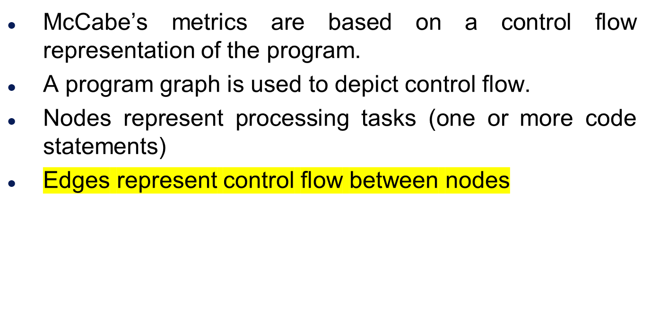


McCabe’s Complexity

Slide 3

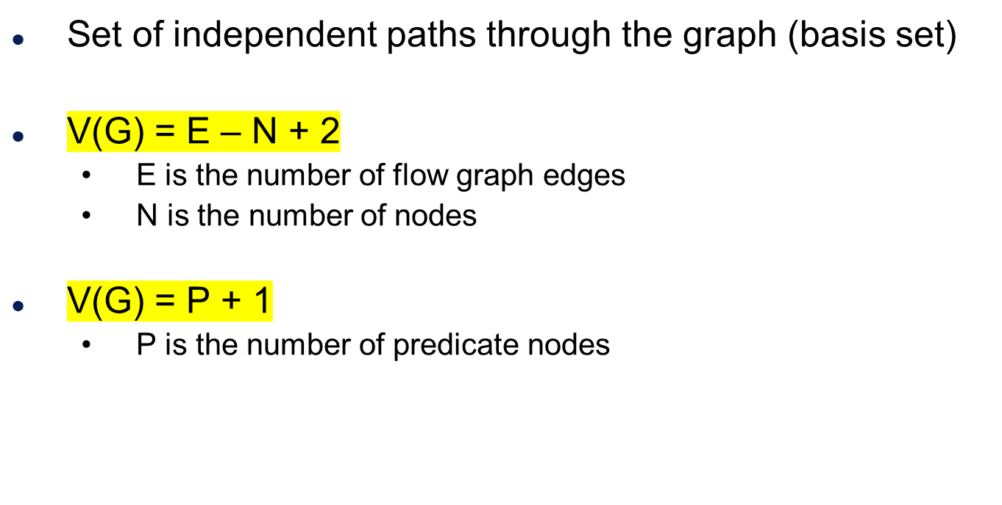

Slide 4
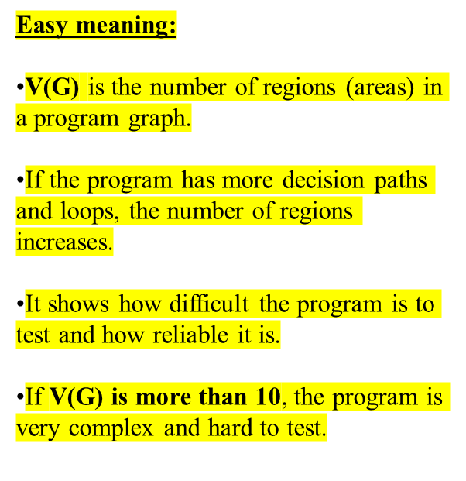
Meaning
V(G) is the number of (enclosed) regions/areas of the planar graph
Number of regions increases with the number of decision paths and loops
A quantitative measure of testing difficulty and an indication of ultimate reliability
Experimental data shows value of V(G) should be no more then 10 - testing is very difficulty above this value

Slide 5

While
Sequence
If-then-else
Until

Slide 6
Example
i = 0;
while (i<n-1) do
j = i + 1;
while (j<n) do
if A[i]<A[j] then
swap(A[i], A[j]);
end do;
i=i+1;
end do;
1
2
3
7
4
5
6

Slide 7
Flow Graph
1
2
3
7
4
5
6

Slide 8
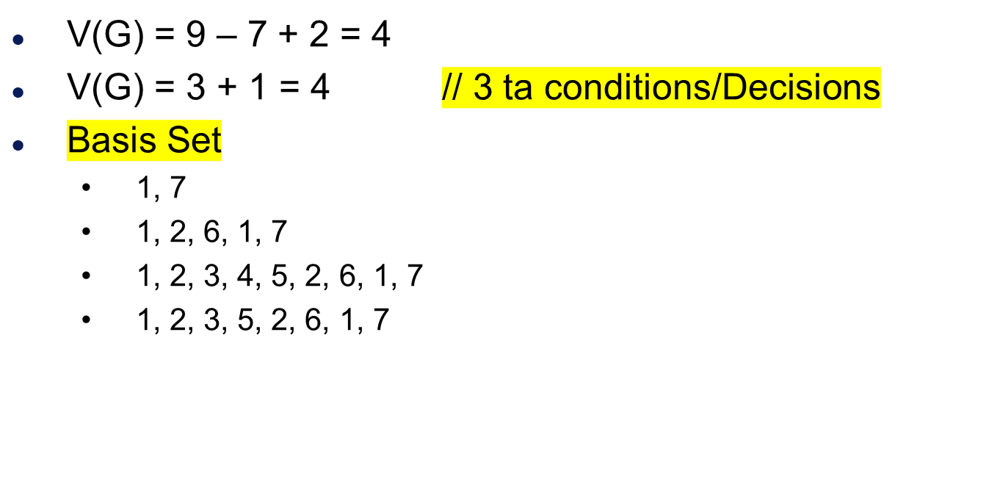
Computing V(G)

Slide 9

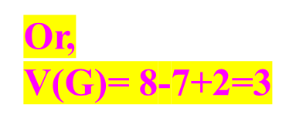
What is the complexity V(G)?
public void howComplex() {
int i=20;
while (i<10) {
System.out.printf("i is %d", i);
if (i%2 == 0) {
System.out.println("even");
} else {
System.out.println("odd");
}
}
}
1
2
3
4
6
5
V(G) = 2 enclosed area + 1 = 3
8
7

Slide 10
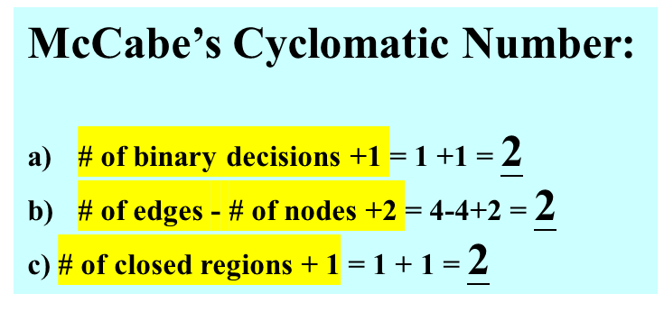
Example
We know there are 2 linearly independent
paths from before:
Path1 : C1 – S3
Path2 : C1 – S2 – S3
S1
1
C1
2
4
Closed region
S2
3
S3

Slide 11
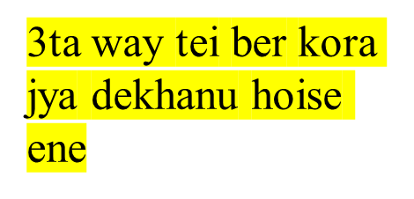
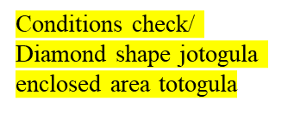
Example
McCabe’s Cyclomatic Number:
# of binary decisions +1 = 2 +1 = 3
# of edges - # of nodes +2 = 7-6+2 = 3
c) # of closed regions + 1 = 2 + 1 = 3
S1
1
4
C1
2
C2
5
S2
Closed Region
S4
Closed Region
7
6
3
S3

Slide 12
END

